Slide 1
Frequency and Time Slots Assignment
Guy Even – Chief Researcher;
Fais Yaniv, Medina Moti, Shahar Shimon, Zadorojniy Alexander

Slide 2
We can present anything we like (including newer stuff).
We must tell a nice and coherent story.
What shall it include?
-scenario generator (mobility modeling)
-path loss model
-algorithm
-simulation
-performance evaluation
-future improvements
Any other stuff?
Who will prepare what?
The limit 20 mins means at most 10 slides.
guy

Slide 3
Background
The goal of this work is to develop a good scheduling algorithm for WiFi networks operating in the 802.11g standard.
Our work is divided into three modules:
  The Scenario Generator – creates “realistic” scenarios.
  The Scheduler – calculates a schedule that maximizes the throughput under interference constraints.
  The Simulator– tests the schedule on OMNET++ and reports the actual throughput.

Slide 4
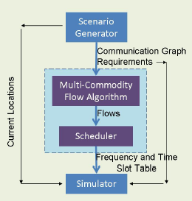
Background – Block Diagram

Slide 5
The Scenario Generator
The Scenario Generator does the following:
  Randomly positions users.
  Randomly chooses source-target requests.
  Calculates the SNR between users.
  Calculates the PER and actual communication rate between users.
  Decides the best MCS for each pair of users.
  Constructs interference graph (which pairs cannot transmit / receive simultaneously).

Slide 6
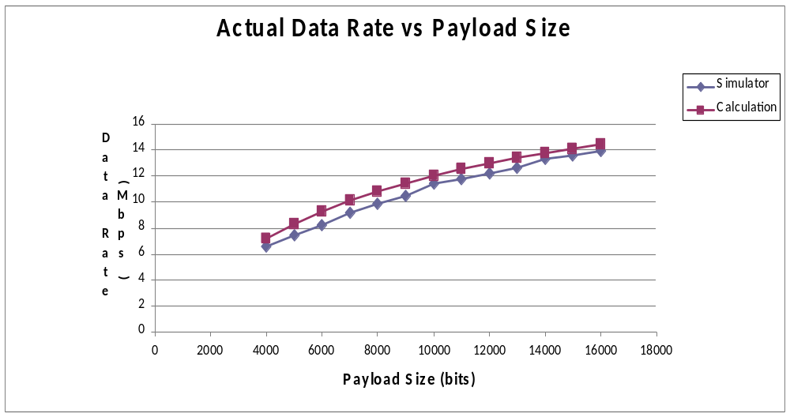
The 802.11g Standard
Comparing the Scenario Generator and OMNet for different payloads (rate = 24mbps)

Slide 7
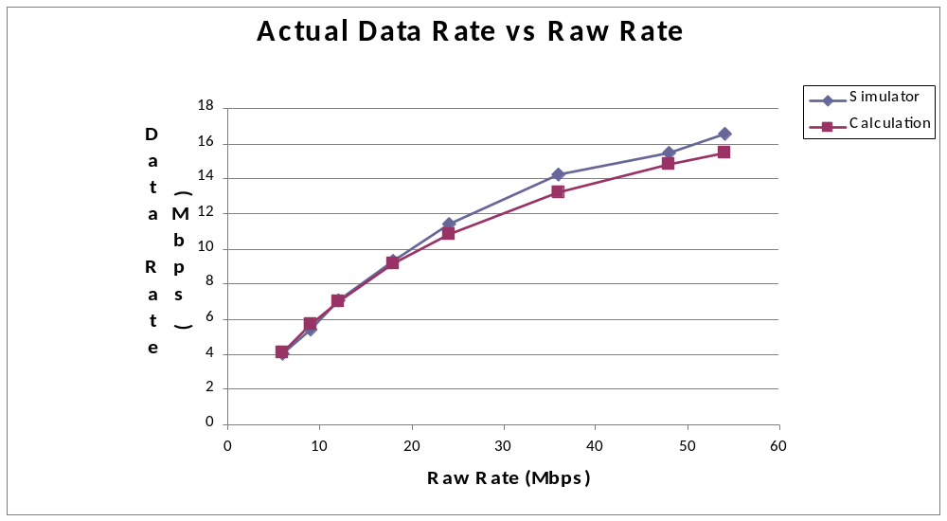
The 802.11g Standard – Cont. I
Comparing the Scenario Generator and OMNet for different rates

Slide 8
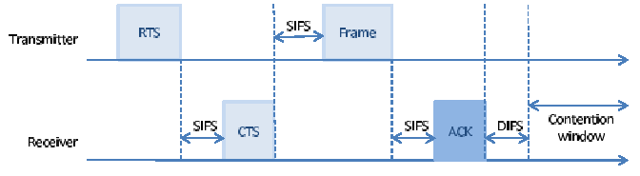
The 802.11g Standard – Cont. II
The 802.11g protocol has the following transmission time diagram.

Slide 9
Path Loss Model
We assumed a model of the form:
  L<db> = B - A * r
  Typical values for A are between 2 and 4.
  We implemented models for urban region.
    The model Elbit provided has A = 4.17.
    According to different papers (Erceg) A = 3.5.
SNR = Power<dbm> - L<db> - Noise <dbm>
Typical power range is 10-20dbm.
Typical noise is -100dbm.

Slide 10
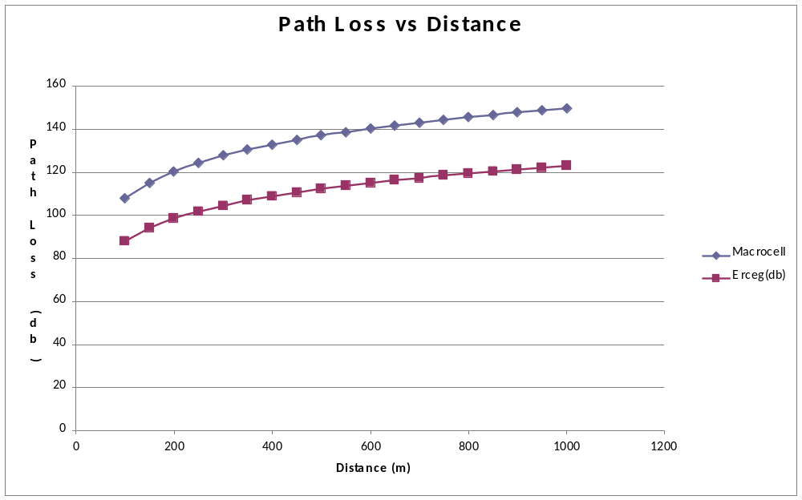
Path Loss Model – Cont.
Comparing the Scenario Generator for different models

Slide 11
PER to SNR Model
We assumed AWGN.
We used simulation to get PER as a function of the SNR and the MCS.
Replacing simulation PER tables by measured data doesn’t require code change in the Scenario Generator.
Based on our choice of parameters we get:
  Communication Radius = 480m
  Interference Radius = 925m

Slide 12
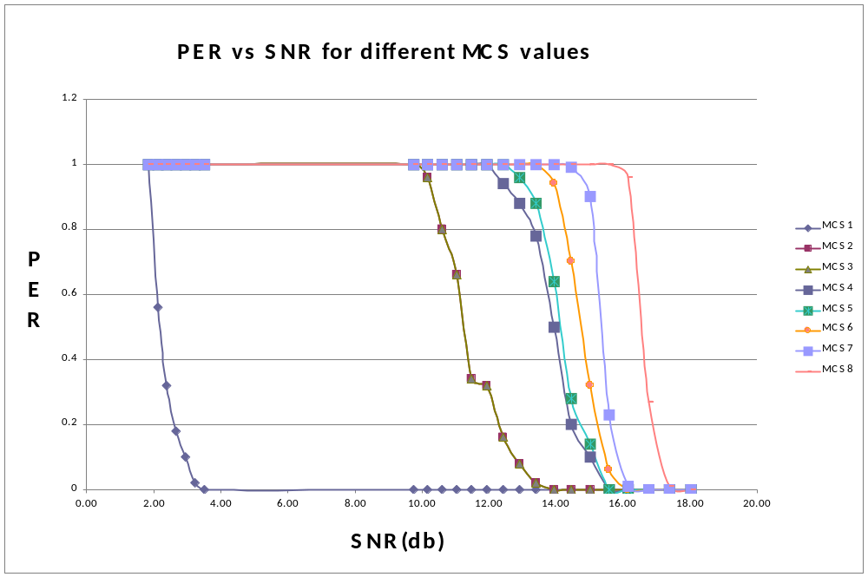
PER to SNR Model – Cont.
Simulation based PER calculation for different SNR and MCS values

Slide 13
The Scheduler
We assume binary interference model.
We assume a single transceiver per user.
We solve the problem in two stages:
  Solve a linear program that models the constraints.
  Generate a schedule by greedy coloring.

Slide 14
Mobility models

Slide 15
Mobility Model Snapshot

Slide 16
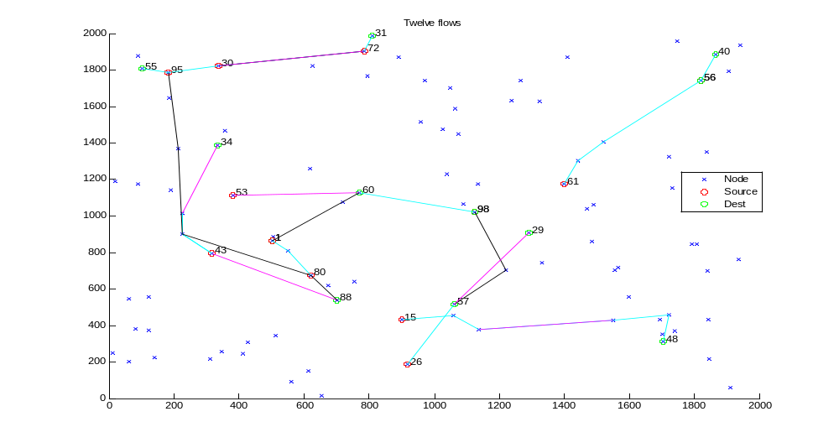
The Scheduler Results
Frequency 1:
Frequency 2:
Frequency 3:

Slide 17
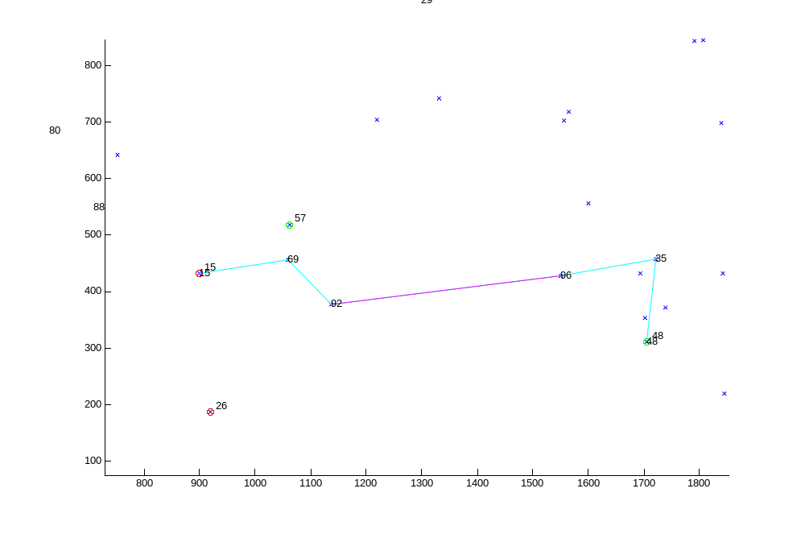
The Scheduler Results – Zoom in
Frequency 1:
Frequency 2:
Frequency 3:

Slide 18
Goals & Milestones
Goals for 6.2010
  Scenario Generator:
    Realistic Modeling – Achieved
  Scheduler
    LP improvements (based on running results)
      Generalization (different radius) – Achieved
      Run time improvement – Achieved
  Simulator
    Validating the Scenario Generator – Achieved
    Integration with the scheduler – Achieved

Slide 19
Goals & Milestones – Cont.
Goals for the third year
  Scenario Generator:
    Dynamic users (constant and arbitrary velocities)
  Scheduler
    Scheduler improvements (based on seen results)
      Optimizing the Queues
  Simulator
    Full integration with dynamic users
    This may imply other improvements in the scheduler.

Slide 20
Normalized Throughput per Stream

Slide 21
Total))Normalized Throughput

Slide 22
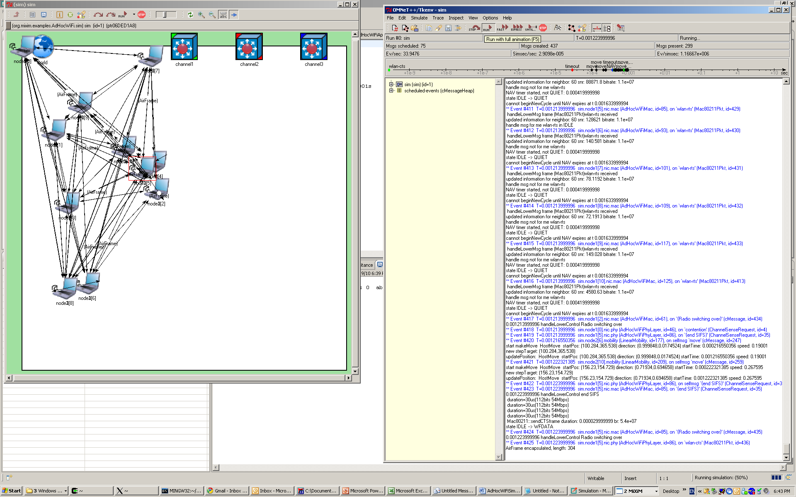
Sim Snapshot

Slide 23
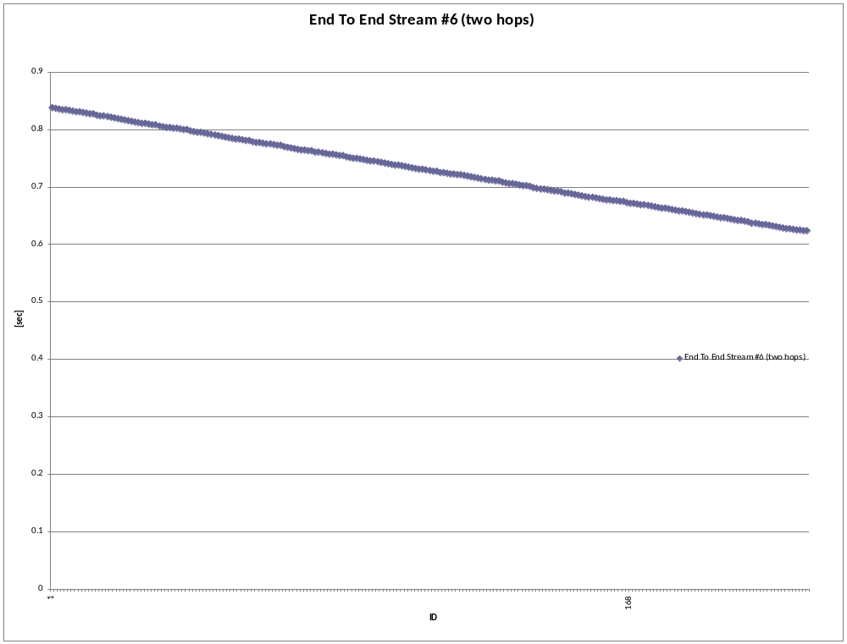
End 2 End delay stream 6 for every packet

Slide 24
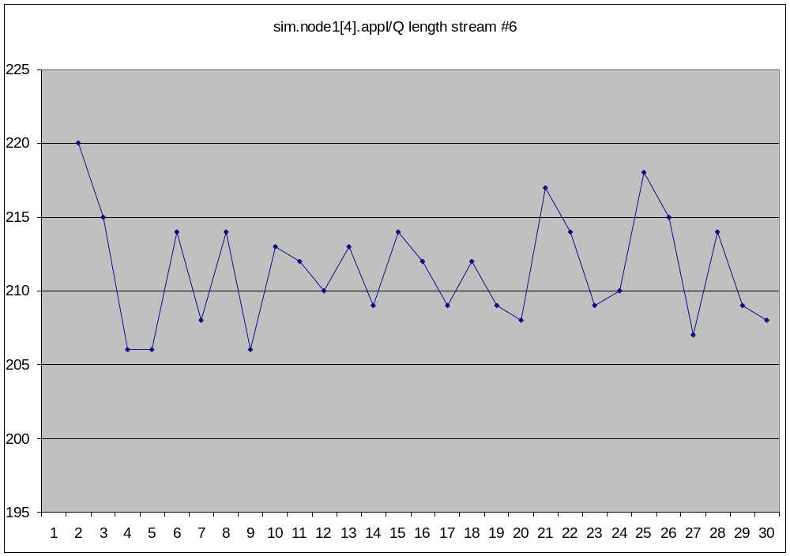
Queue length per node per time per stream

Slide 25

Total Queue length per node

